Slide 1
pH Meter
By
Dr. Nelson Xess
Department of Microbiology
Bhanupratap Deo Govt. P.G College, Kanker, Chhattisgarh

Slide 2
pH Meter
A pH meter is a scientific instrument that measures the hydrogen ion activity in water based solution , indicating its acidity or alkalinity expressed as pH.
The pH meter measures the difference in electrical potential between a pH electrode and a reference electrode, and so the pH meter is sometimes referred to as a "potentiometric pH meter". The difference in electrical potential relates to the acidity or pH of the solution.
The hydrogen ion concentration or pH is a measure of the acidity or alkalinity of solution.
The pH value of substance is directly to the ratio of hydrogen ion [H+] and the hydroxyl ion [OH-]

Slide 3
The material is acidic if H+ concentration is greater than OH- the pH value is less than 6.5
The material is neutral if H+

Slide 4
Principle of operation
Potentiometric pH meters measure the voltage between two electrodes and display the result converted into the corresponding pH value.
They comprise a simple electronic amplifier and a pair of electrodes, or alternatively a combination electrode, and some form of display calibrated in pH units.
It usually has a glass electrode and a reference electrode, or a combination electrode. The electrodes, or probes, are inserted into the solution to be tested.

Slide 5
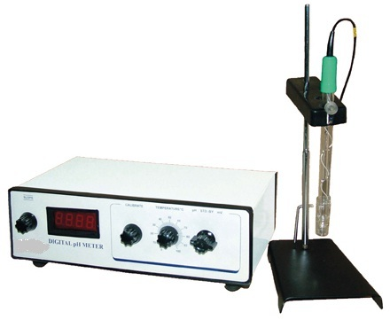
pH Meter
Scale of pH meter = 0 to 14 pH.
An acidic solution = less than 0-6.5
A basic solution = greater than 7.5
A neutral solution = 6.5 – 7.5

